Slide 1


Internship Presentation 2020-2021
ROBOTIC PROJECTS
INTERNAL GUIDE EXTERNAL GUIDE
Mr. RAGHAVENDRA M Mr. PRATEEK KUMAR BAISHKHIYAR
Assistant Professor Technical Manager
Dept. of ECE, PESIT-BSC PINWHEEL ROBOTICS
NAME : RANJAN R
USN : 1PE17EC101
11/08/2021
PESIT BSC

Slide 2
ABOUT PINWHEEL ROBOTICS
Pinwheel Robotics is a Robotics Research & Development Company. They take up R&D projects on Robotics and build prototype.
They have in-house team of designers , circuit designers , sensor design and programmer who can program microcontroller.
They provide solutions and products to educational institutions to enable them in delivering STEM based education for the classrooms.
Pinwheel Robotics brings the most novel and practical way of learning the concepts of Science, Technology, Engineering and Mathematics(STEM) to the Future Scientists and Engineers of the nations.
11/08/2021
PESIT BSC

Slide 3
TASK ASSIGNED
To design a ‘Two axis fabric punch automated CNC’, and work on its assembly.
The design will be showcased as a technology demonstration to the client.
To design the assembly of a ‘War combat Robot’.
Generate a report for the same explaining all the functionalities to be published on the companies site blog.
11/08/2021
PESIT BSC

Slide 4
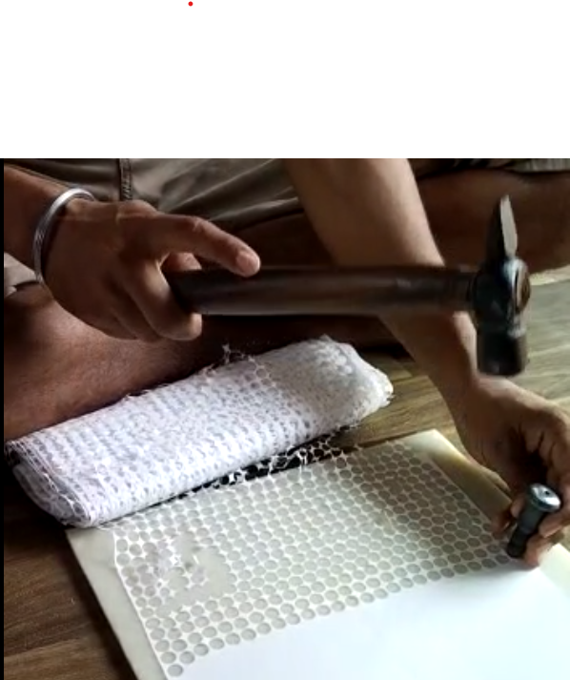
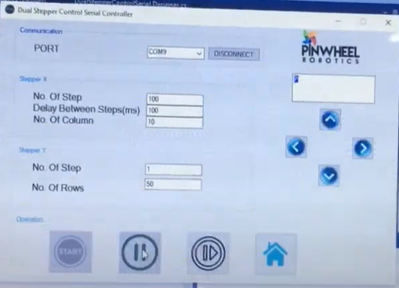
AIM TO BE ACHIEVED
The task is to automate this task.
It must be controlled by a User Interface
The UI consists of:
Start
Stop
Resume
Increment
Decrement
Restart
11/08/2021
PESIT BSC

Slide 5
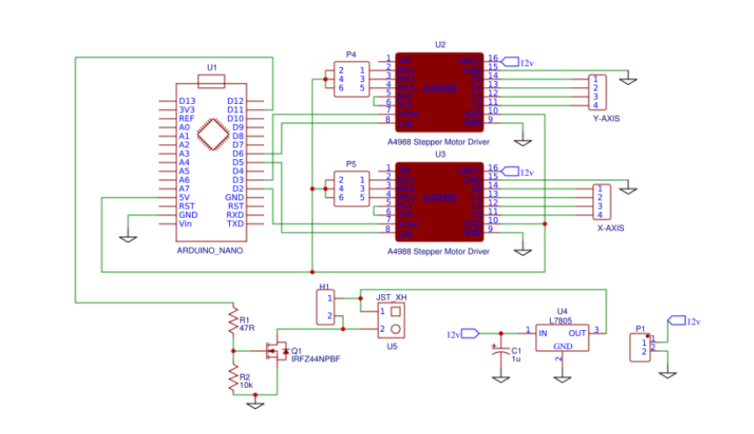
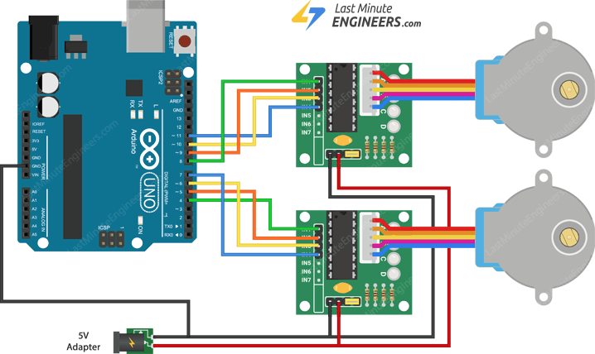
CIRCUIT DIAGRAM
11/08/2021
PESIT BSC

Slide 6
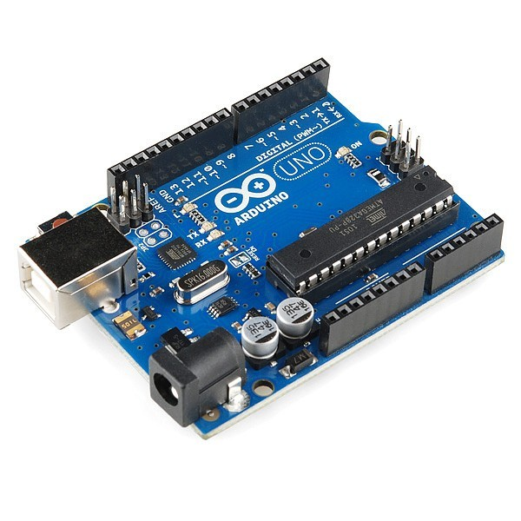
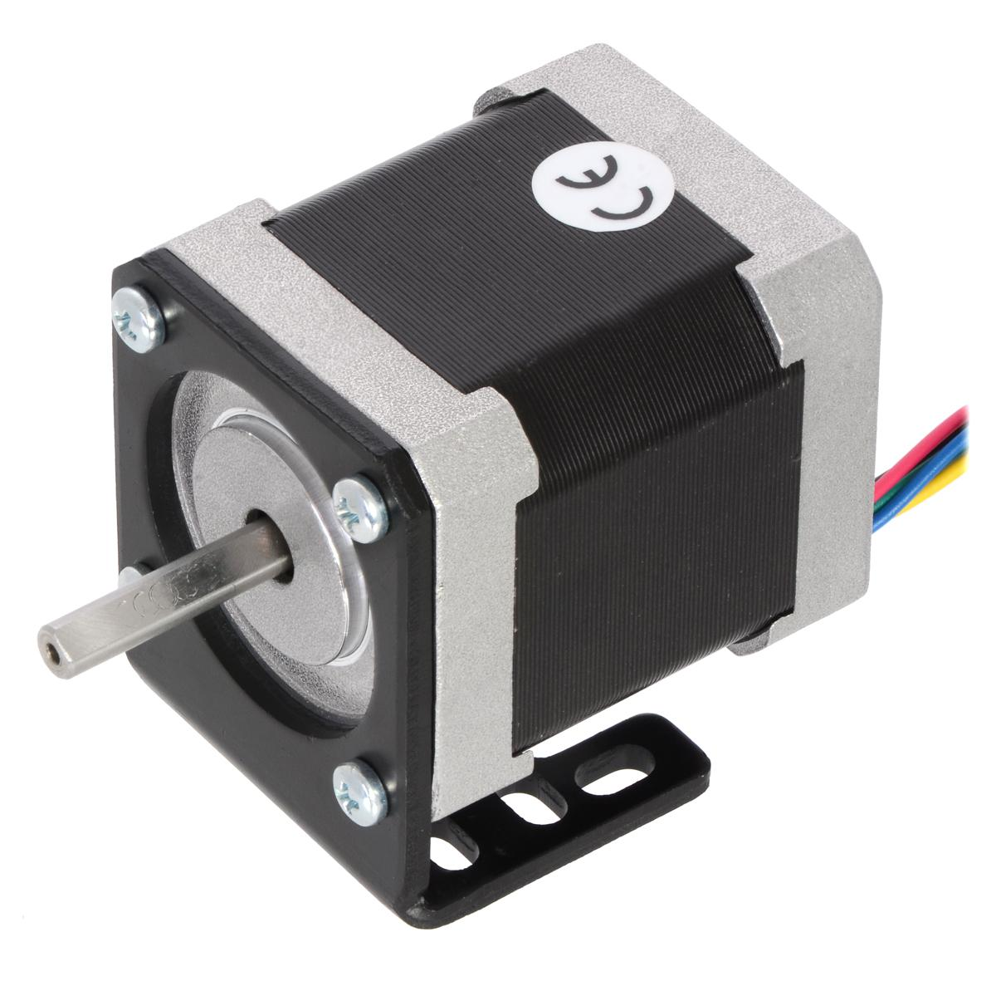
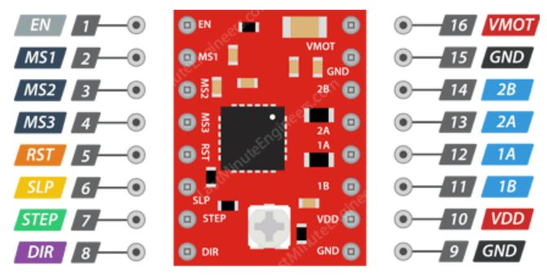
COMPONENTS USED
A4988 Stepper Motor Driver Chip
NEMA 17 Stepper Motor
Arduino Uno
11/08/2021
PESIT BSC

Slide 7
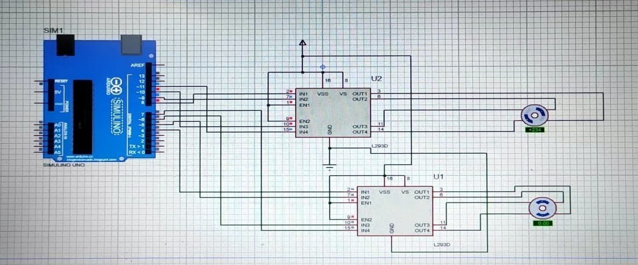
SIMULATION USING PROTEUS
11/08/2021
PESIT BSC

Slide 8
MATHEMATICAL CALCULATION
Suppose a cloth of length = 50cm and the Radius of circle to be cut out = 1cm.
For most efficient cut, The stepper in x direction cuts a circle at (1,1) of radius 1cm.
Movement of 2cm along the x axis, New coordinate (3,1) and it Moves till the end.
Total steps moved= (50-2)/2=24 steps.
Subtraction of 2 is done because it starts from (1,1) and ends at (49,1).
So, the motor moves by 24 steps
Now movement of y by 2 cm and the motor in x axis moves from (49,3) to (1,3).
Process repeats till y reaches end.
11/08/2021
PESIT BSC

Slide 9
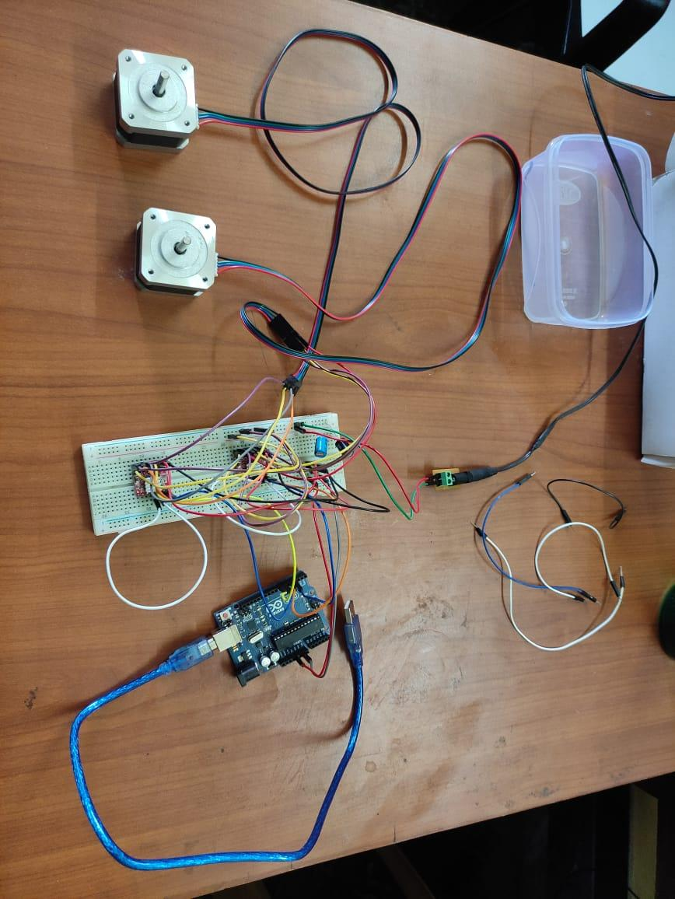
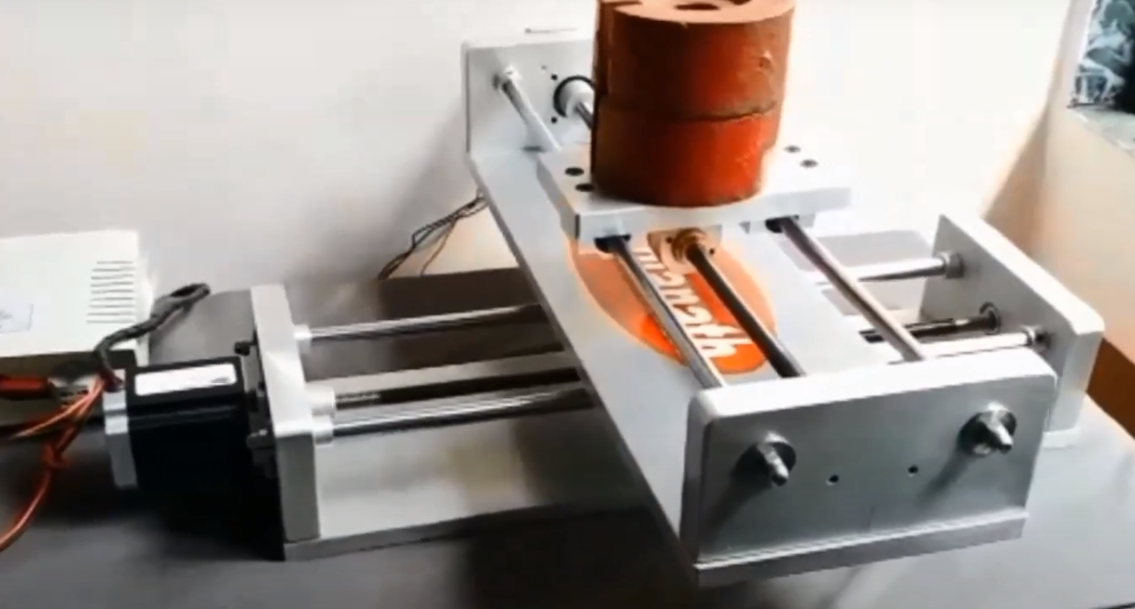
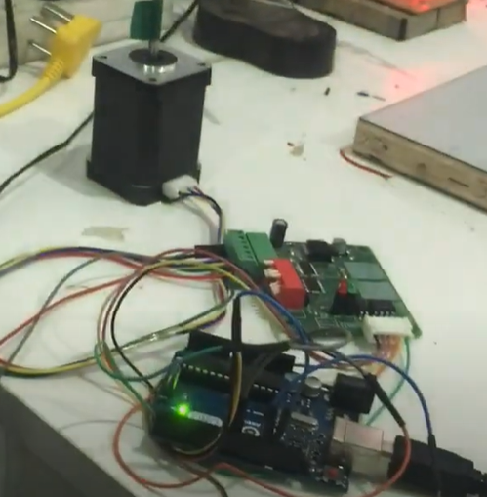
WORK DONE
PROPOSED MODEL
11/08/2021
PESIT BSC

Slide 10
ACHIEVED RESULTS
It shows zigzag motion.
Can increment and Decrement based on requirements.
Steps of rotation can be varied according to the length of fabric.
Able to pause and resume at any instant we wish to.
Minimize vibrations in the motor, by controlling the applied dc.
Emergency Stop functionality was tested, and intended results were achieved.
11/08/2021
PESIT BSC

Slide 11
WAR COMBAT ROBOT
Towards the end of the internship we were assigned a project of assembly of robot which consists of robotic hand on a mobile platforms.
We planned upon the type of sensors and functionalities to equip it with.
This was a robot targeted for STEM program. This will be transformed to a DIY kit for high school students.
This platform allows to interface different sensors and actuators, thus being a great learning tool.
11/08/2021
PESIT BSC

Slide 12
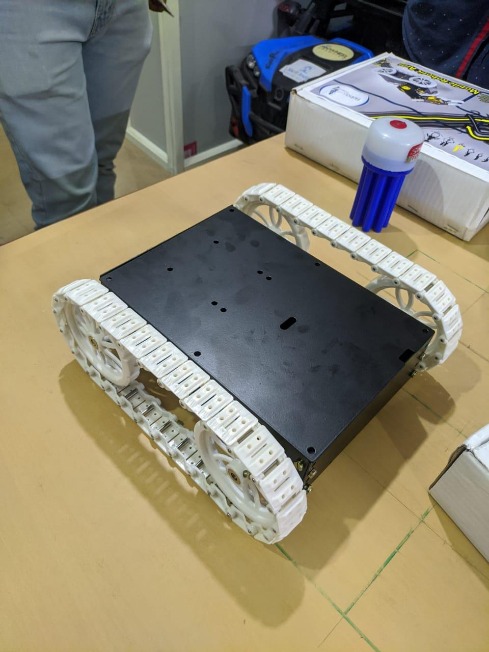
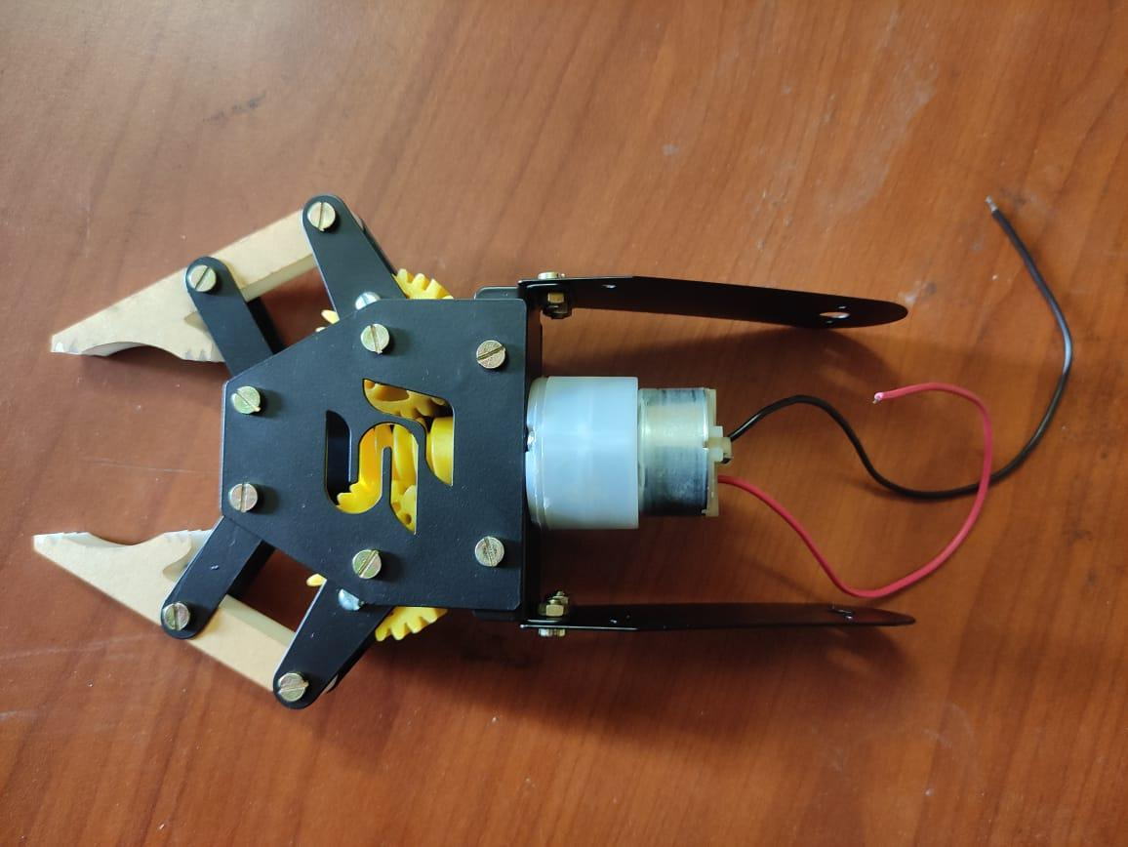
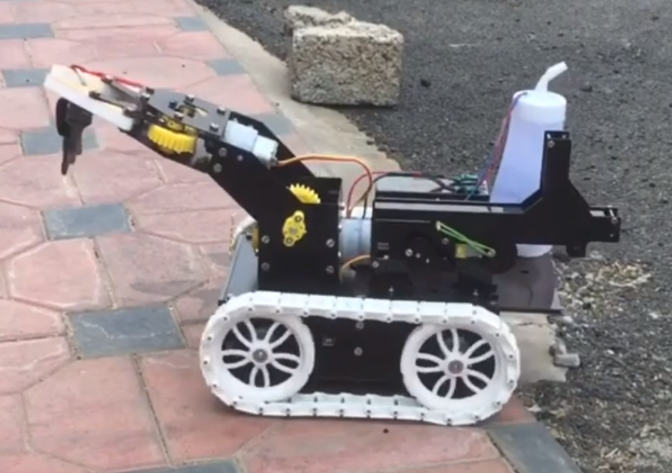
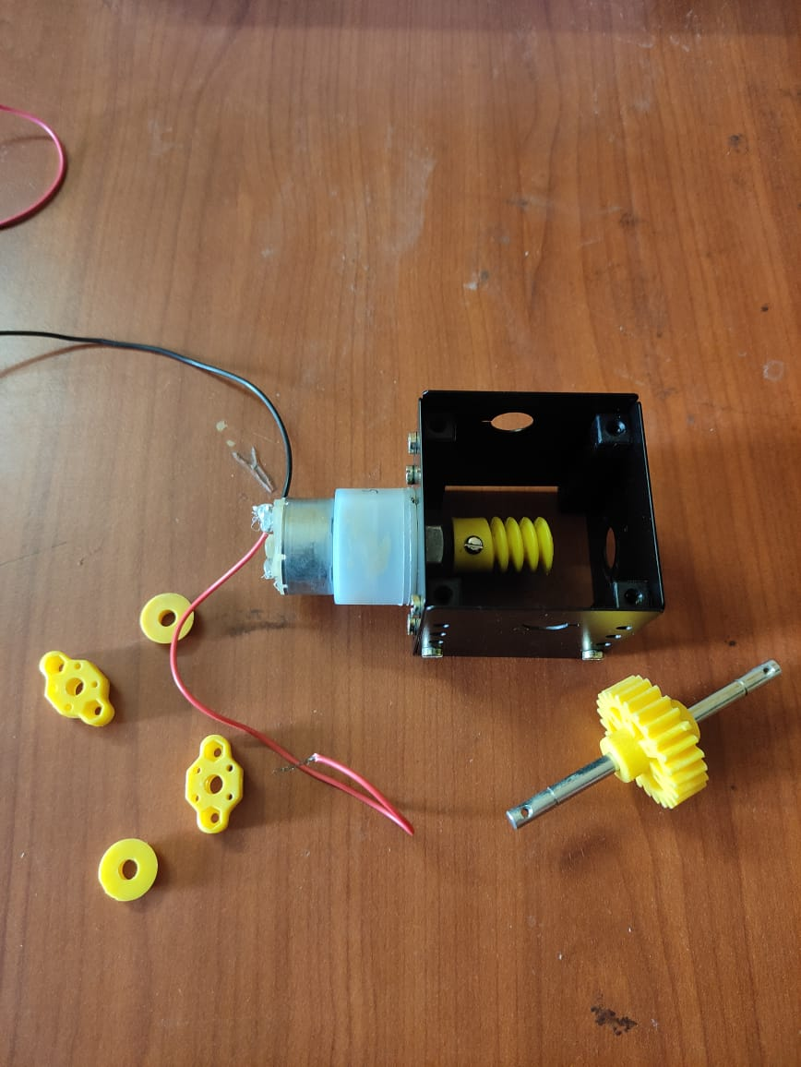
INTERMEDIATE PHASES
FINAL MODEL
11/08/2021
PESIT BSC

Slide 13
OUTCOMES
TECHNICAL OUTCOME
The major technical learnings were with respect to interfacing arduino with different sensors, using Proteus and code debugging. Moreover to understand the coordination of the backend and the frontend, and how the documentation must be done for smoother project flow.
NON-TECHNICAL OUTCOME
1. Teamwork
2. Networking
3. Time Management
4. Taking positive criticism
11/08/2021
PESIT BSC

Slide 14
THANK YOU
11/08/2021
PESIT BSC

